Slide 1

Learning Notes on TranSync
Prepared for Transync-M Grand Ave Field Visit
August 31st, 2022

Slide 2
ADOT Field Visit Plan
Plan:
Drive the north end of Grand Ave from 163rd Ave to 99th Ave
Using Transync-M to collect data and check the performance of the existing timing plans.
The corridor is approximately 11 miles long and it’ll take about 20 minutes to drive it one way
Meeting Time:
Wednesday August 31st at 5:00 am at 1802 W Jackson St Phoenix AZ 85007 (ADOT AMP)
Or You can meet us at 5:30 am at 16949 W Deer Valley Rd, Surprise, AZ 85387 to drive the morning peak 5 times each way
Contact person:
ASU Dr. Xuesong (Simon) Zhou, 801-696-5651
Damaris S. (Susy) Gomez, ADOT Traffic Engineer Specialist
(928)503-7095.

Slide 3
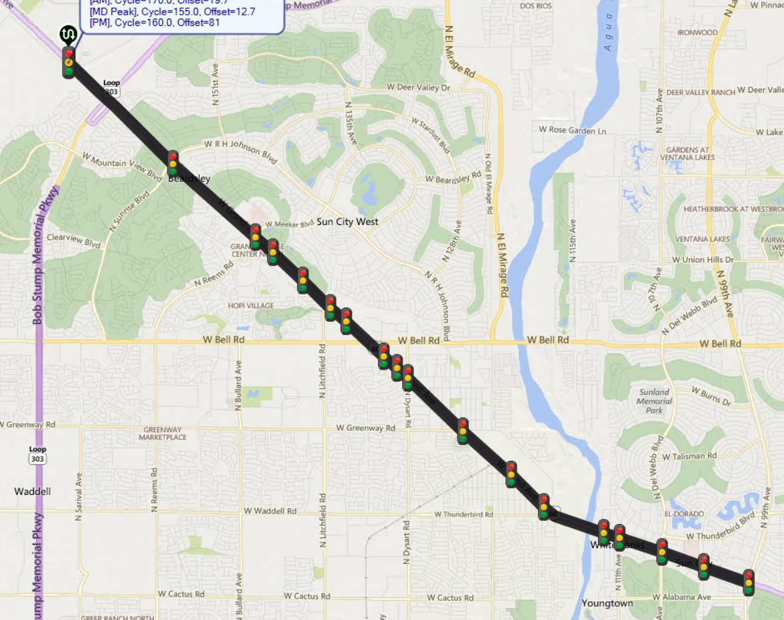
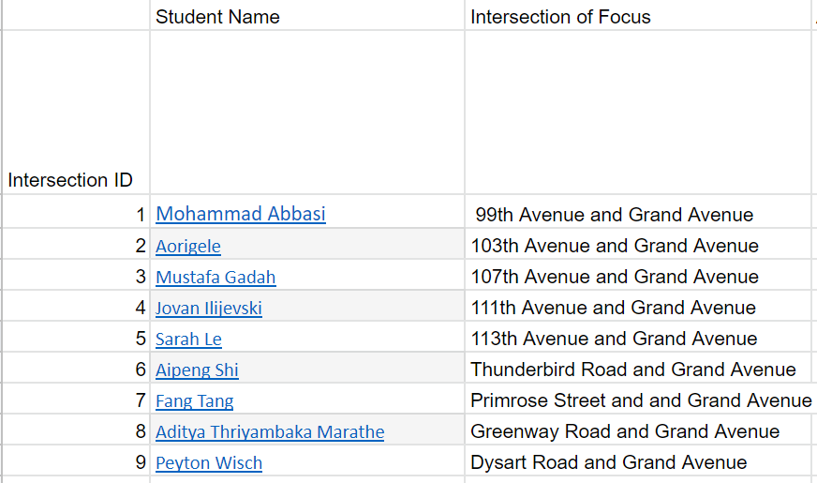
18
17
16
15
14
13
12
11
10
9
8
7
1
6
5
4
3
2
1

Slide 4
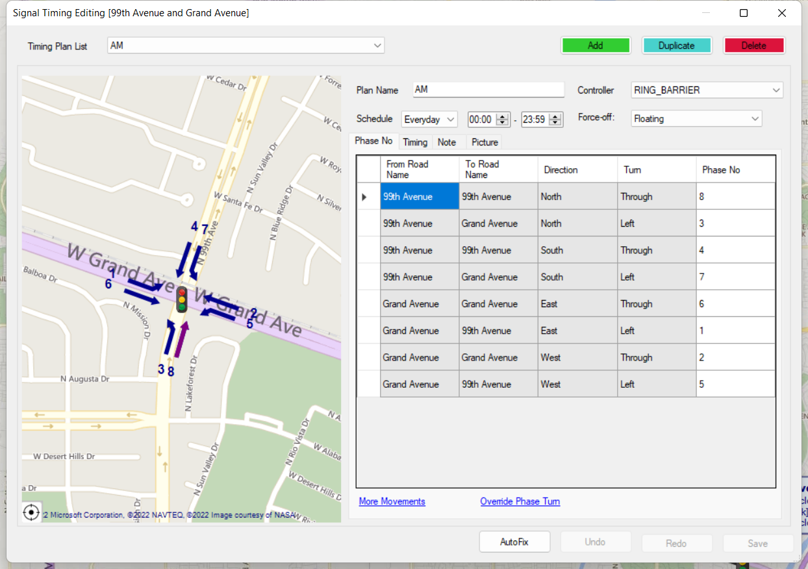
1

Slide 5
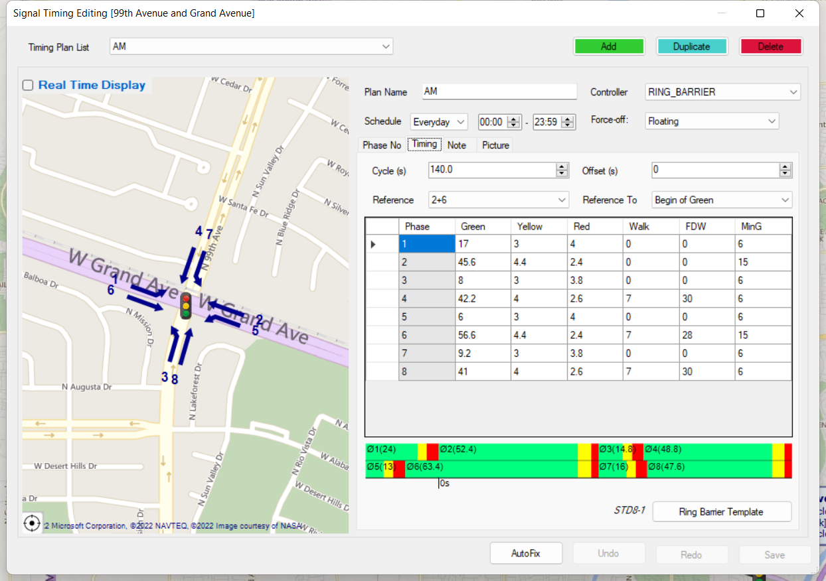
1

Slide 6
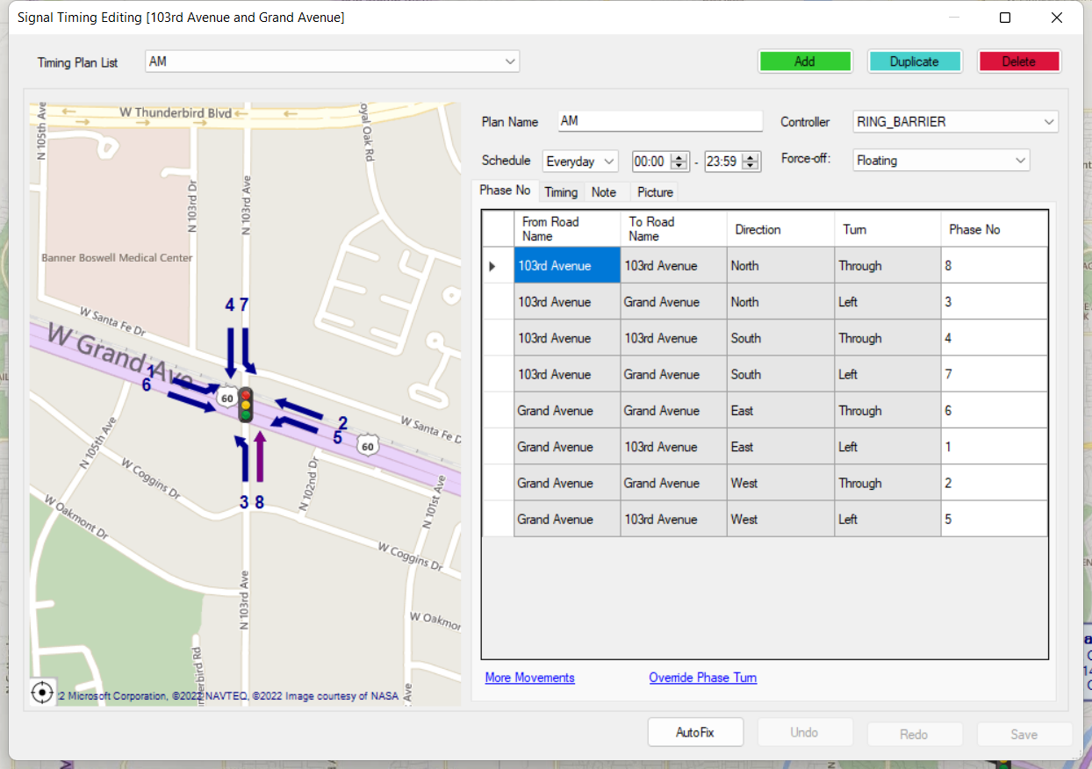
2

Slide 7
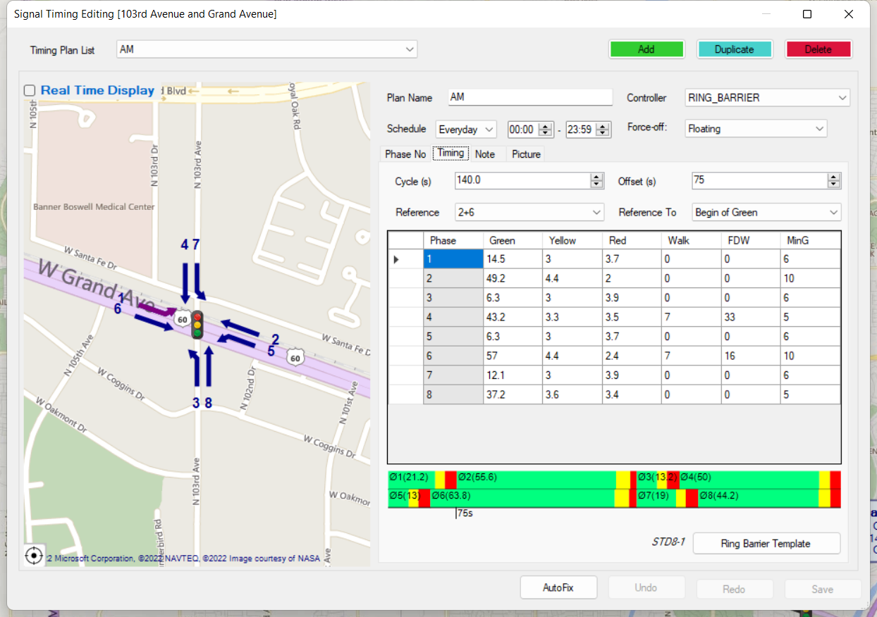
2

Slide 8
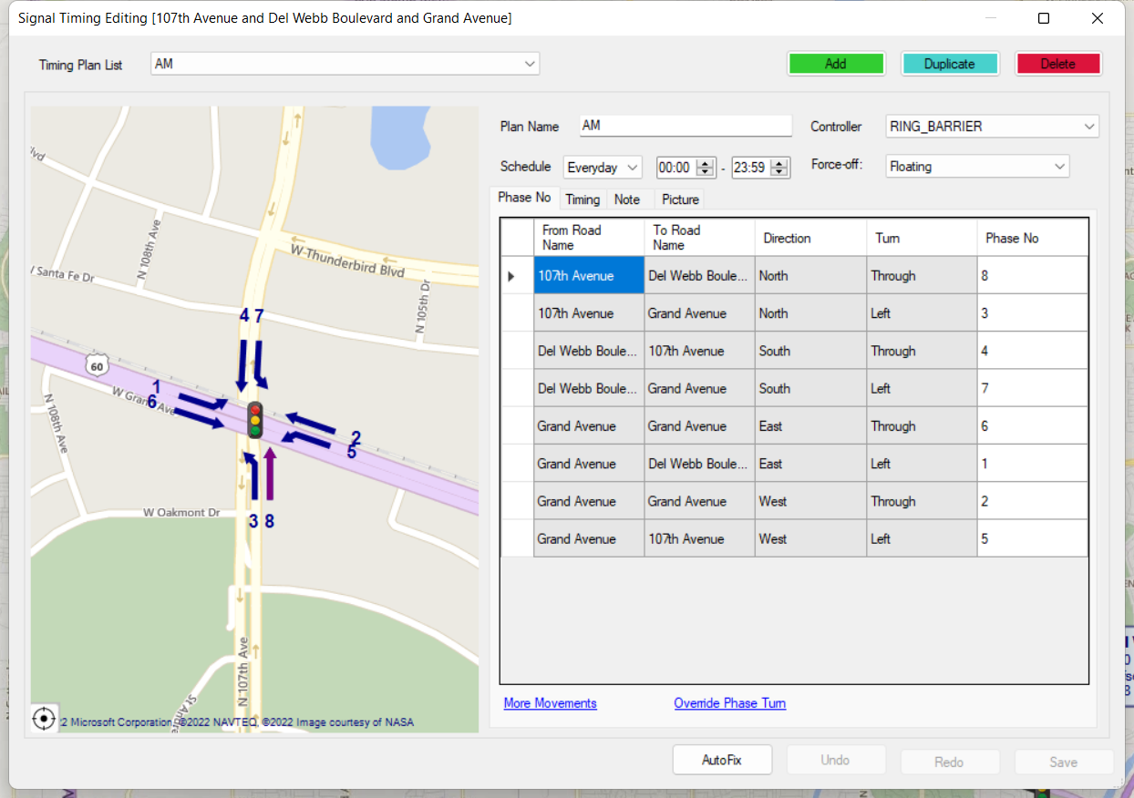
3

Slide 9
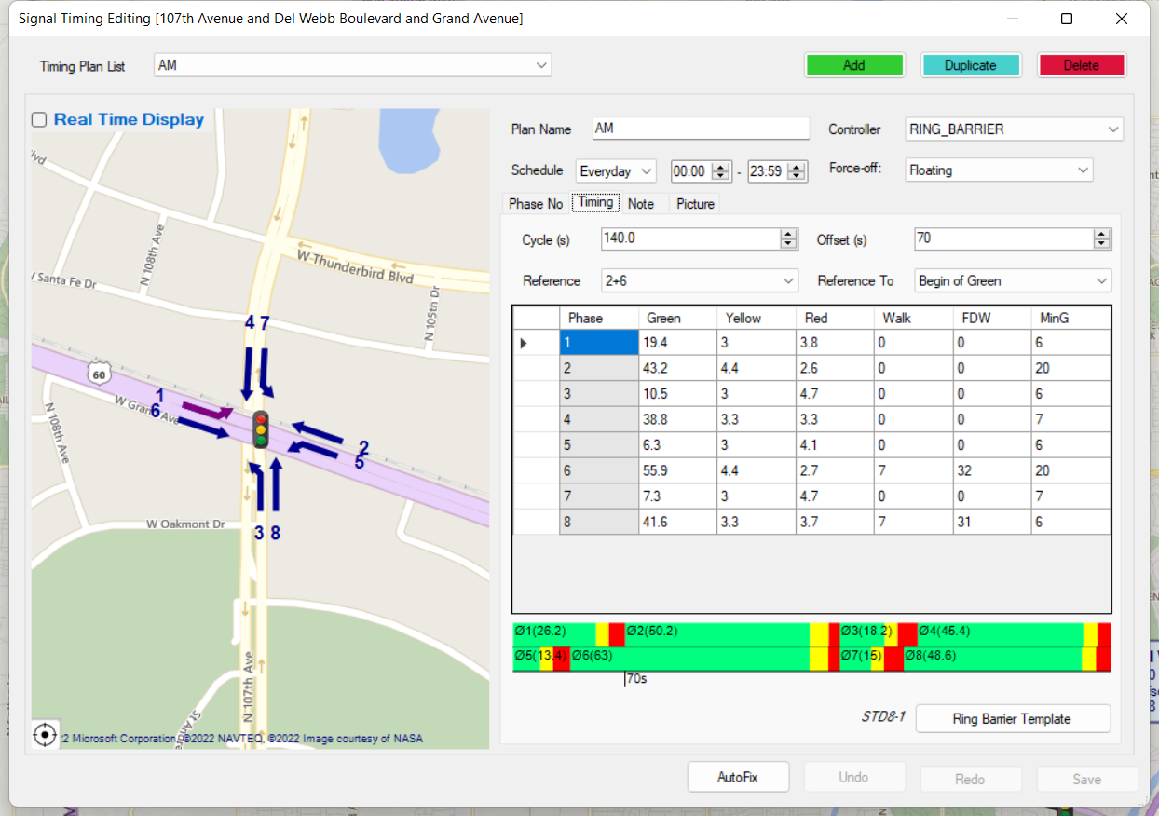
3

Slide 10
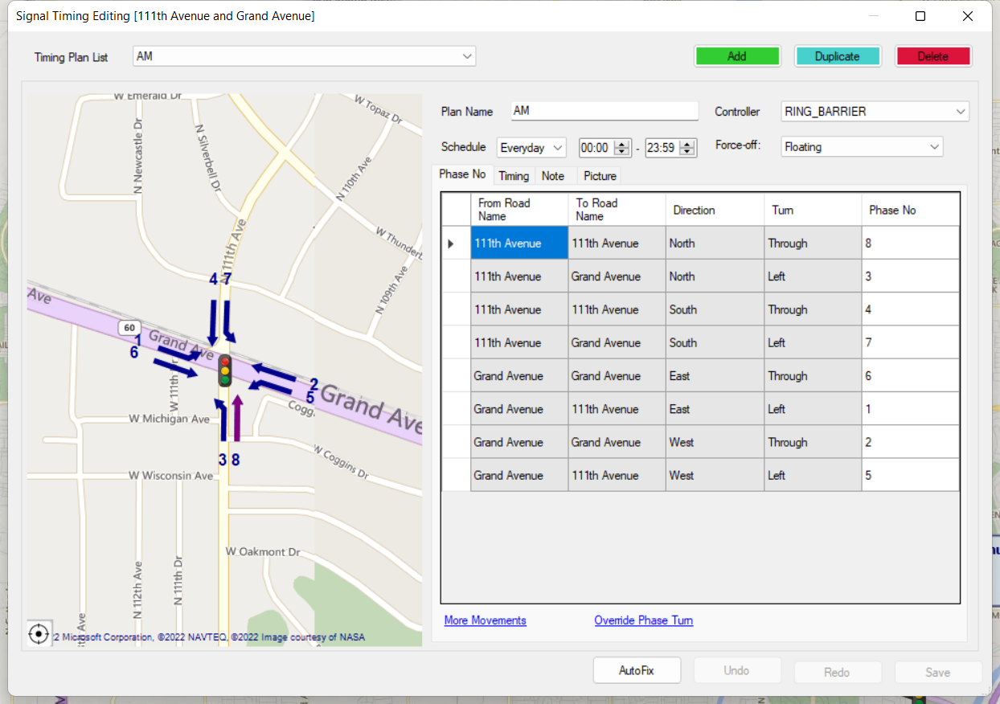
4

Slide 11
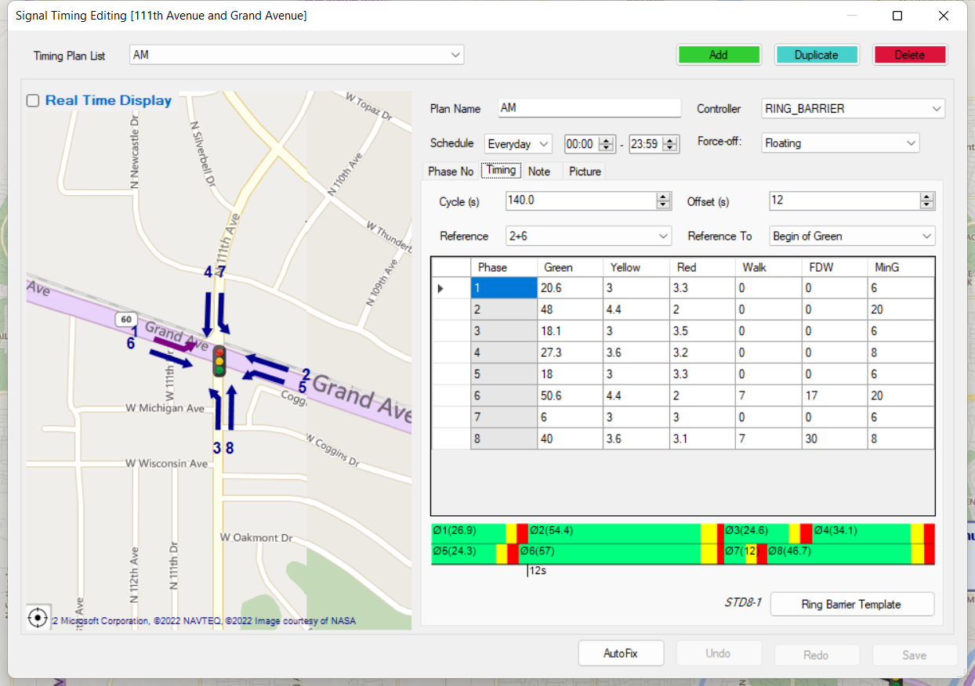
4

Slide 12
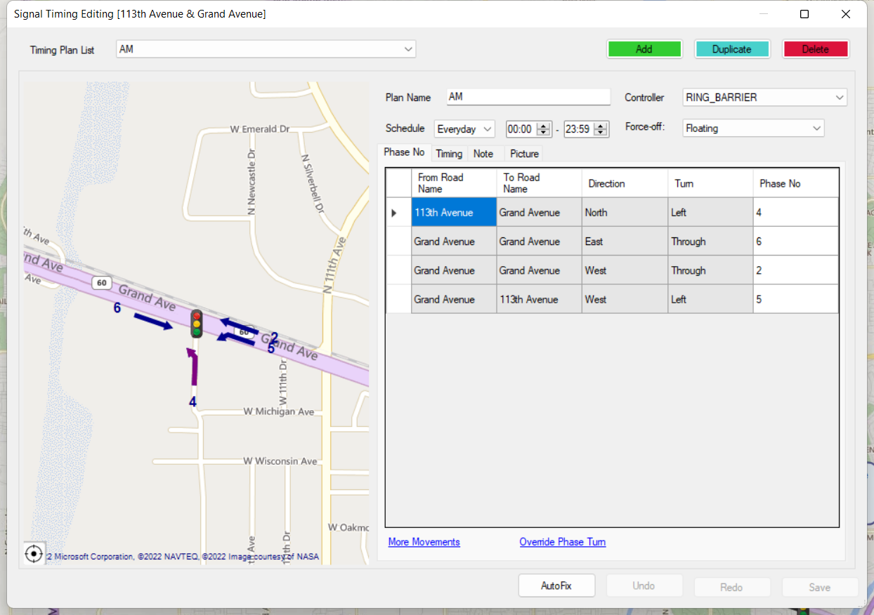
5

Slide 13
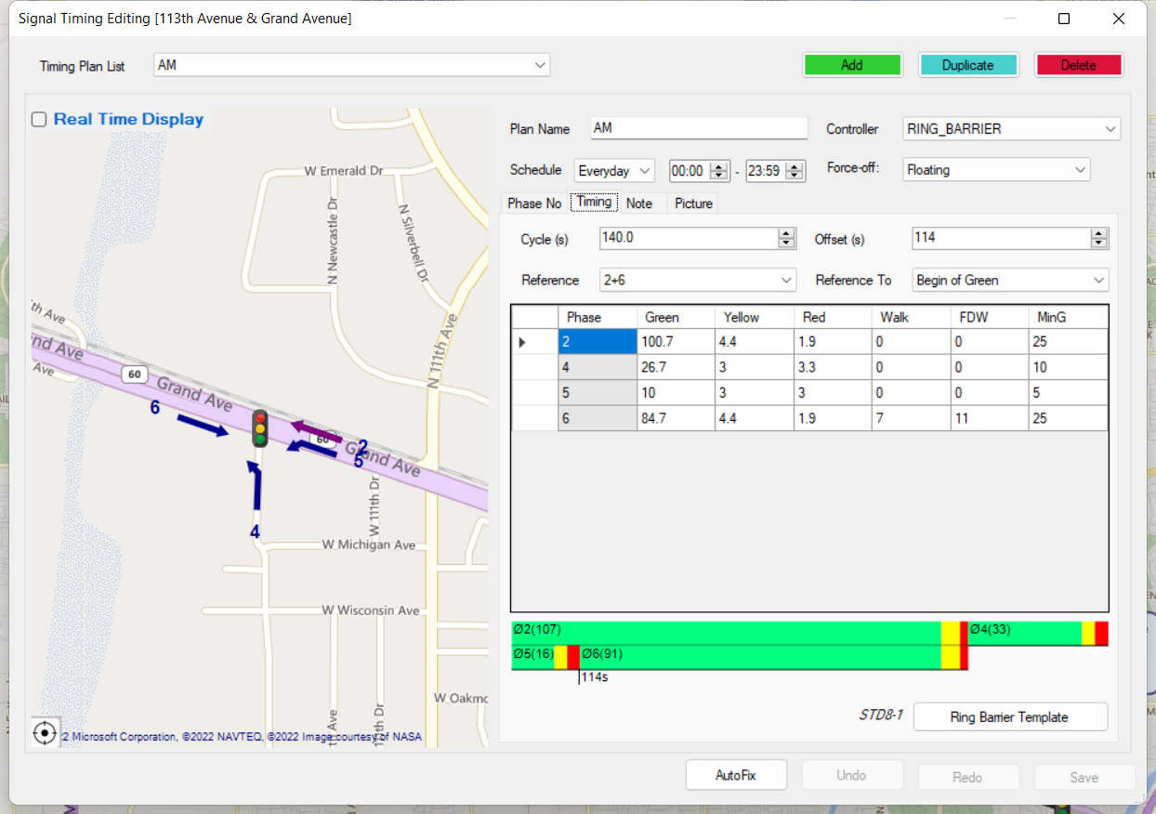
5

Slide 14
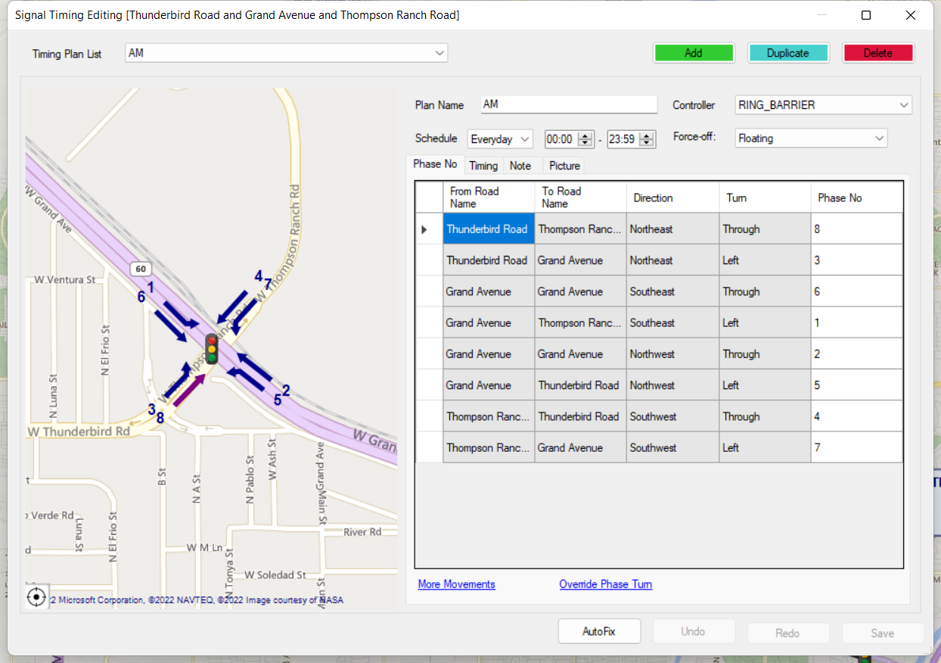
6

Slide 15
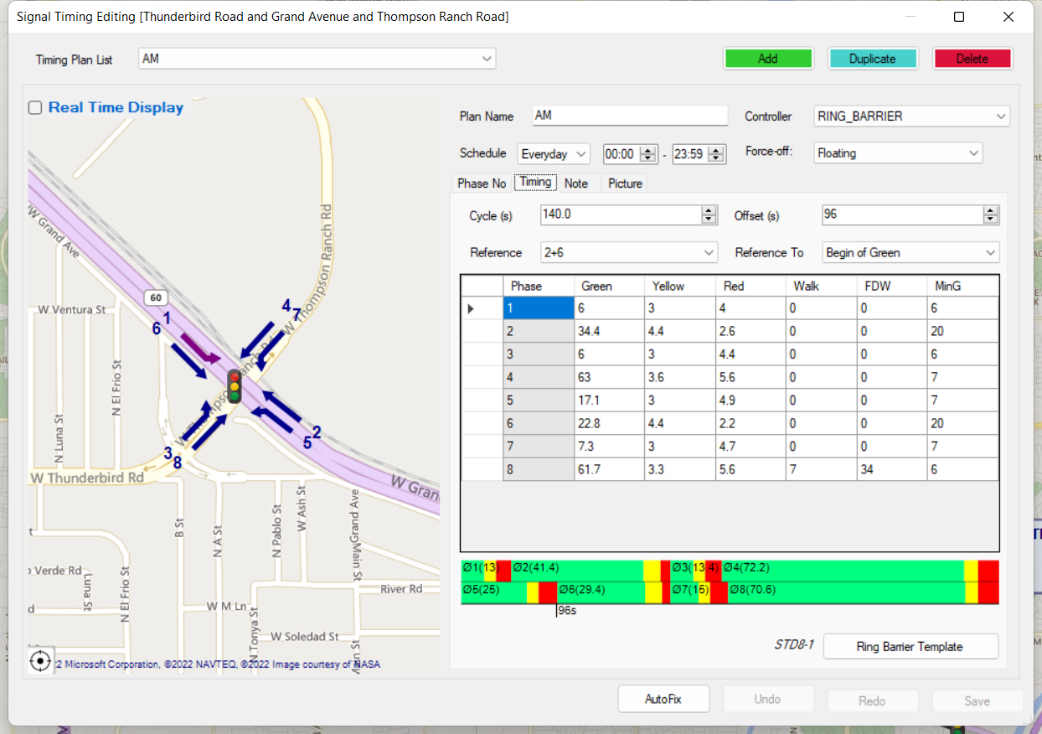
6

Slide 16
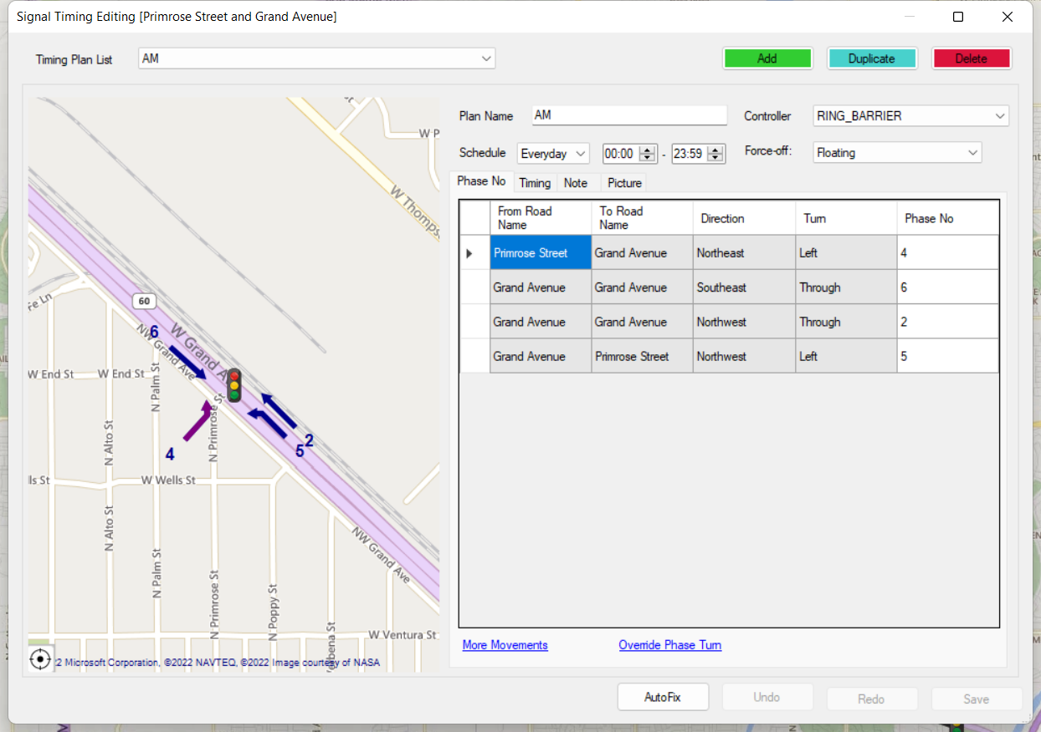
7

Slide 17
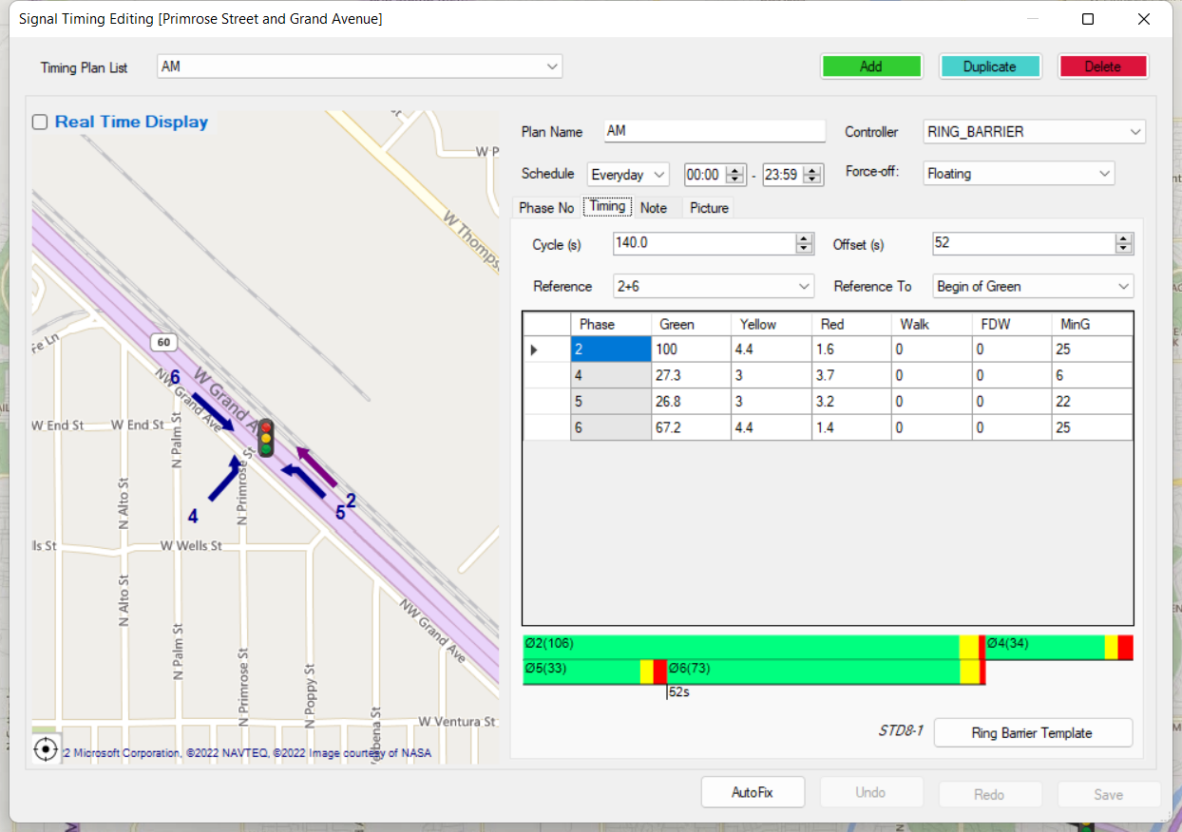
7

Slide 18
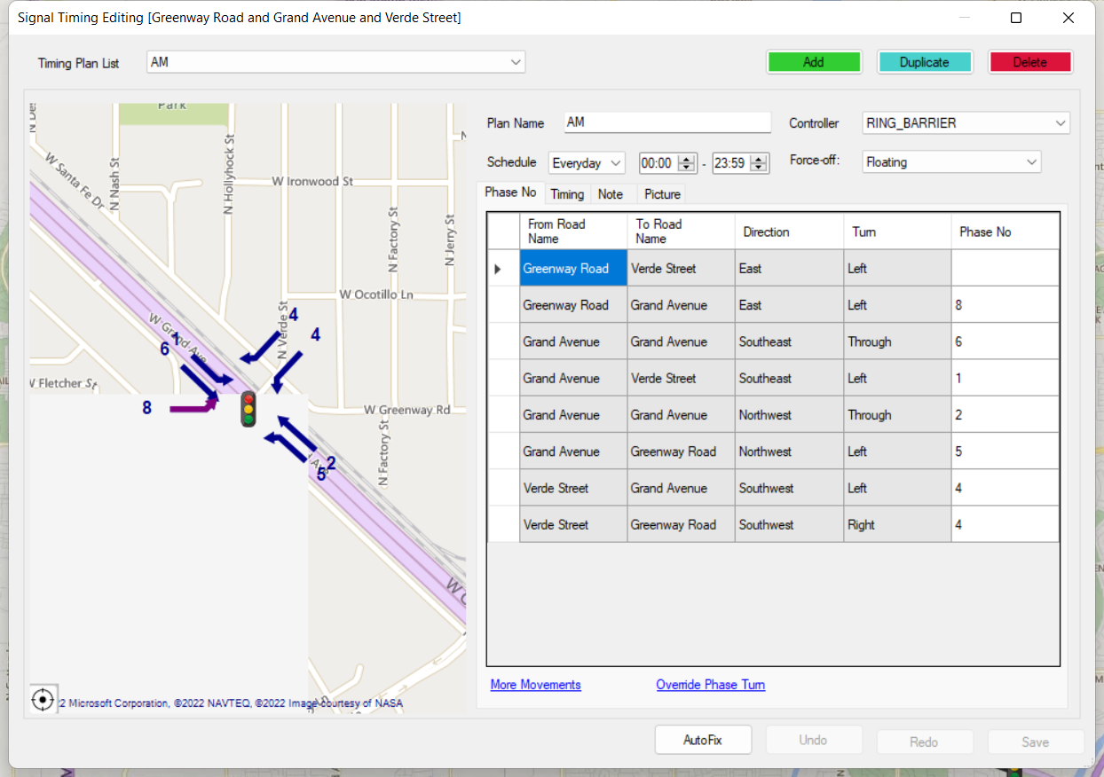
8

Slide 19
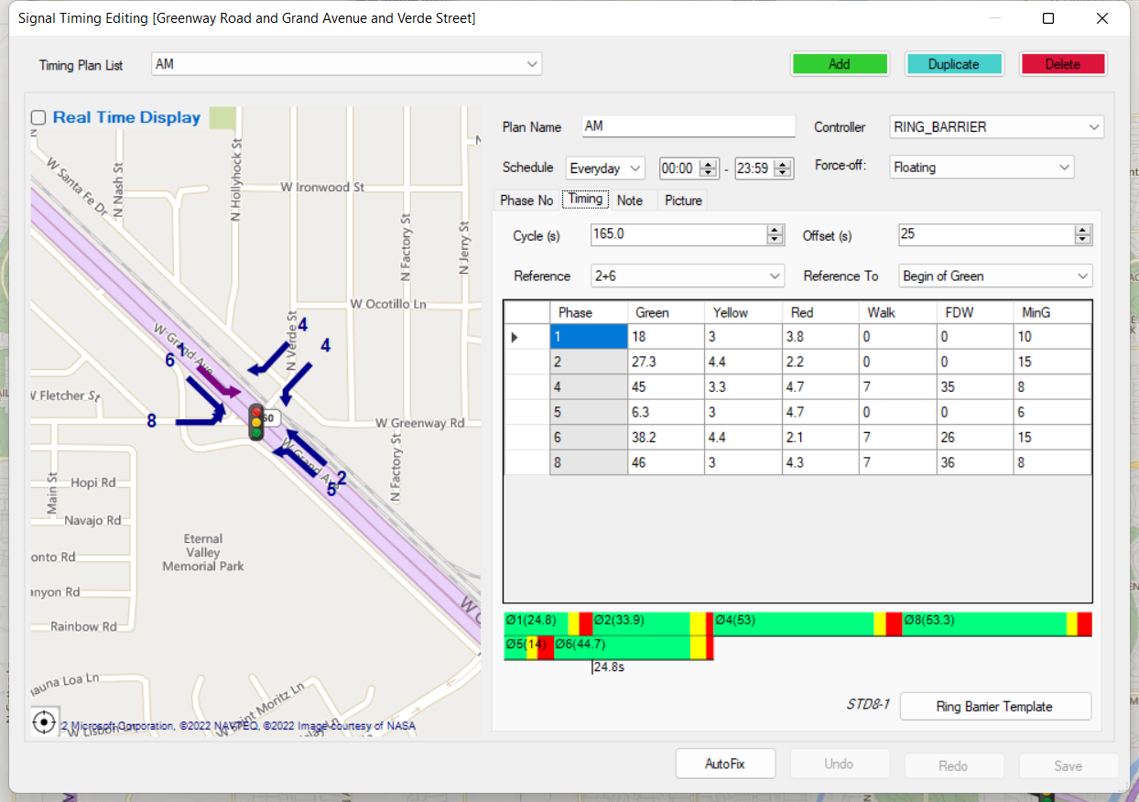
8

Slide 20
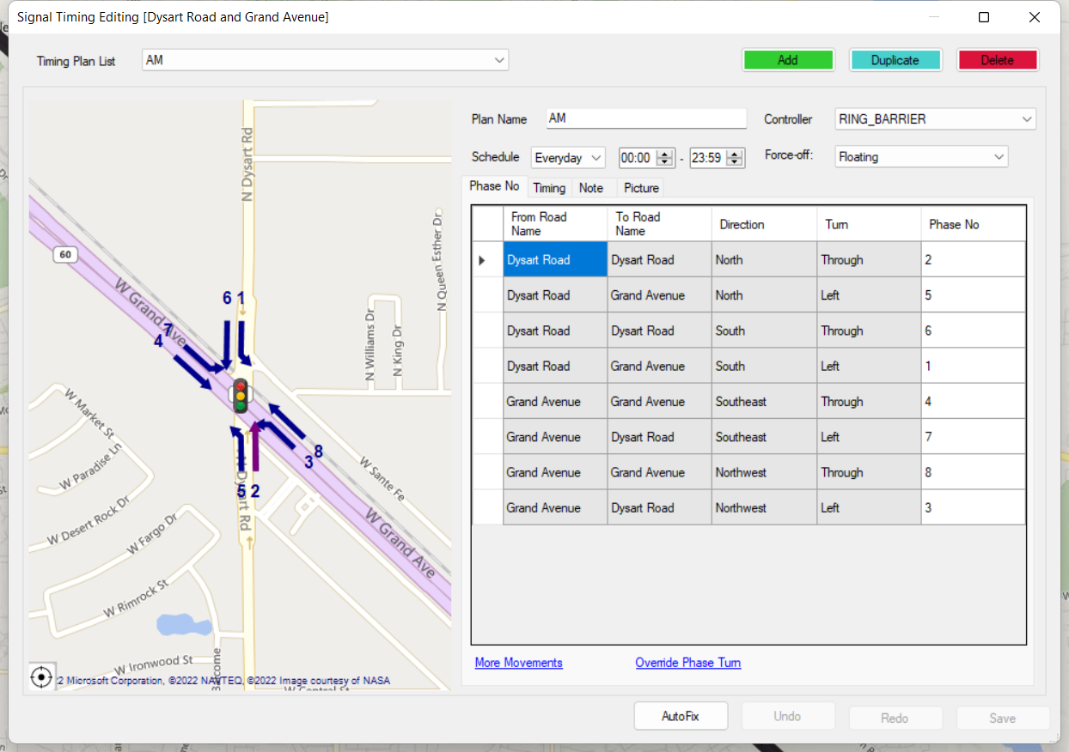
9

Slide 21
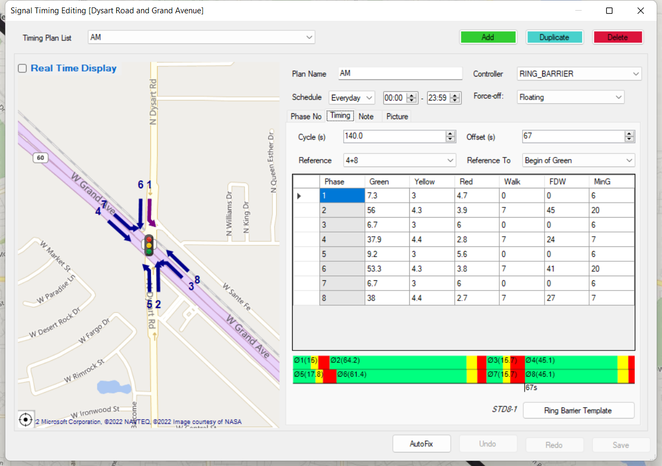
9

Slide 22
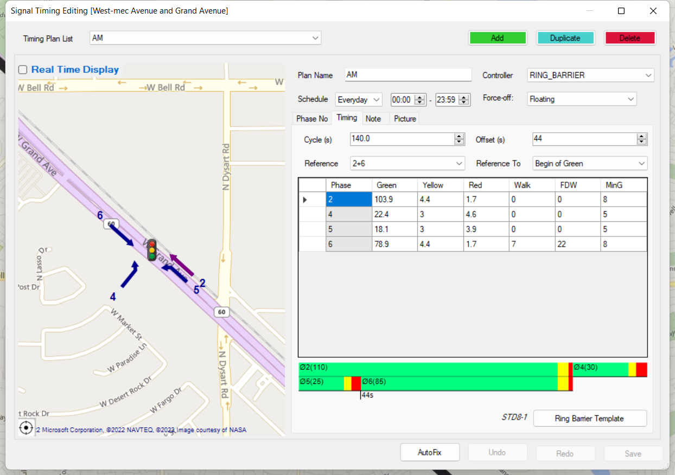
10

Slide 23

11

Slide 24
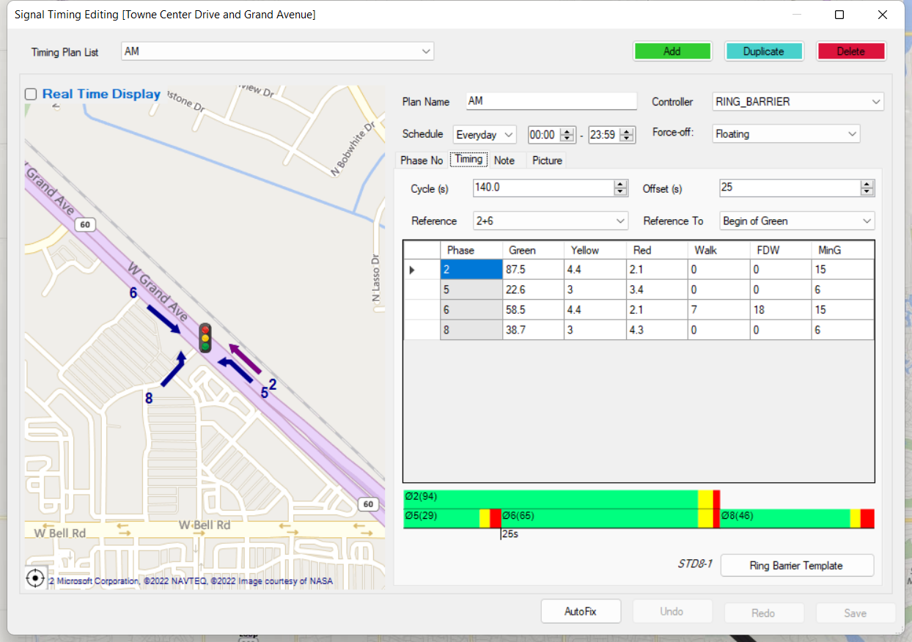
12

Slide 25
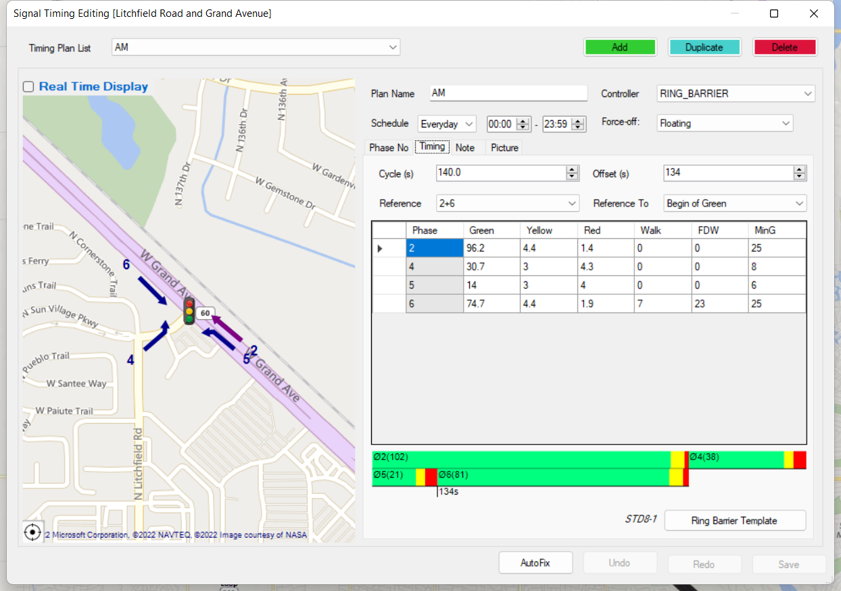
13

Slide 26
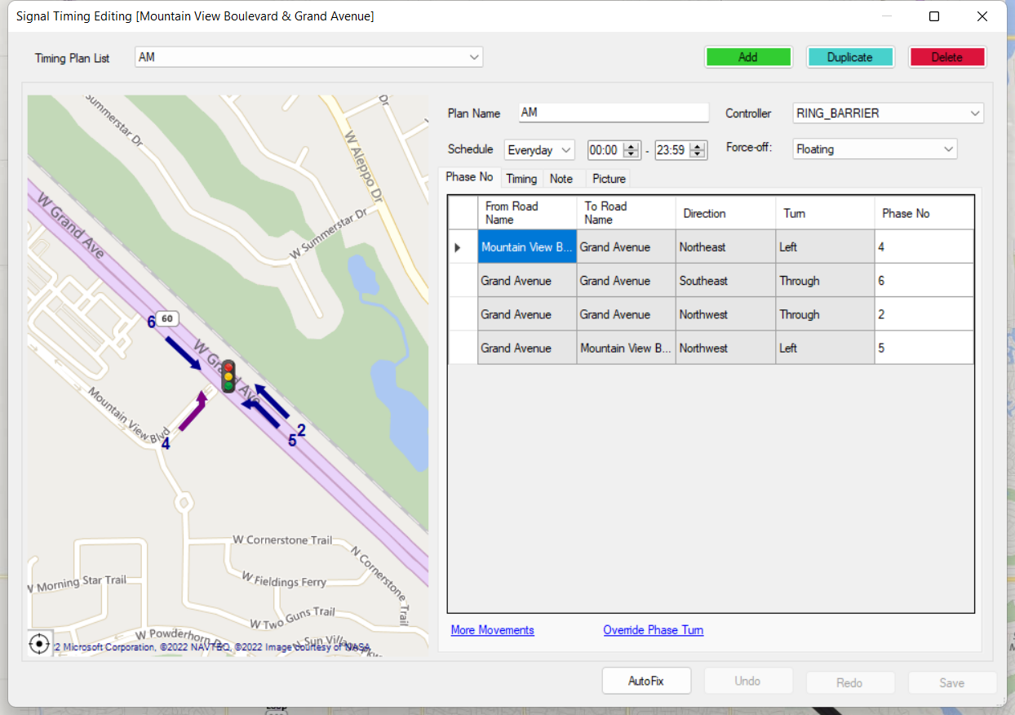
14

Slide 27
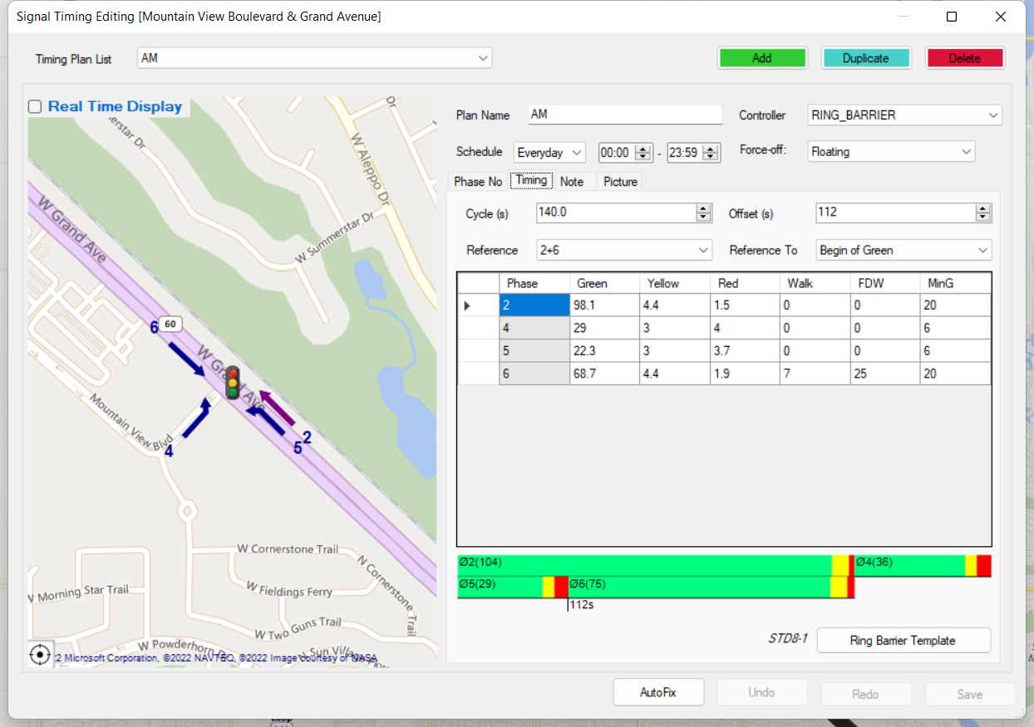
14.

Slide 28
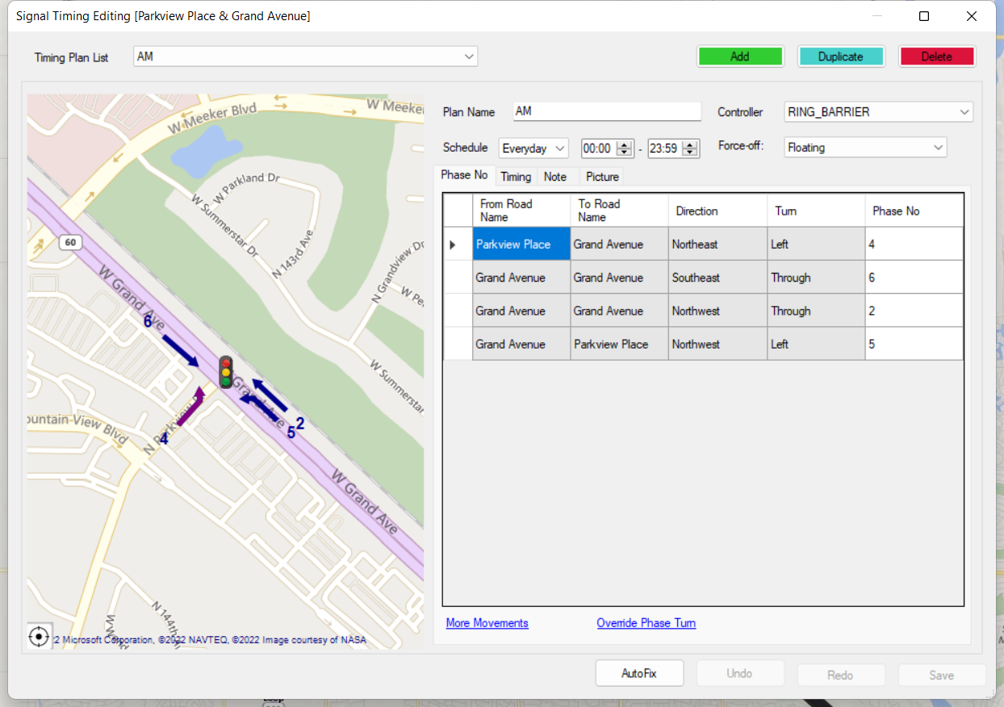
15.

Slide 29
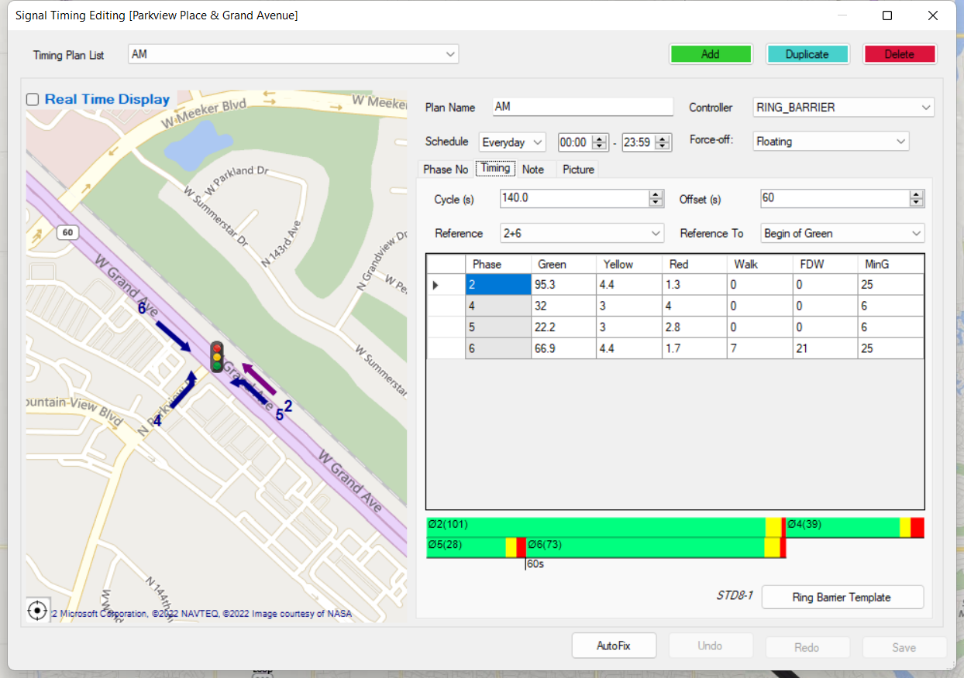
15

Slide 30
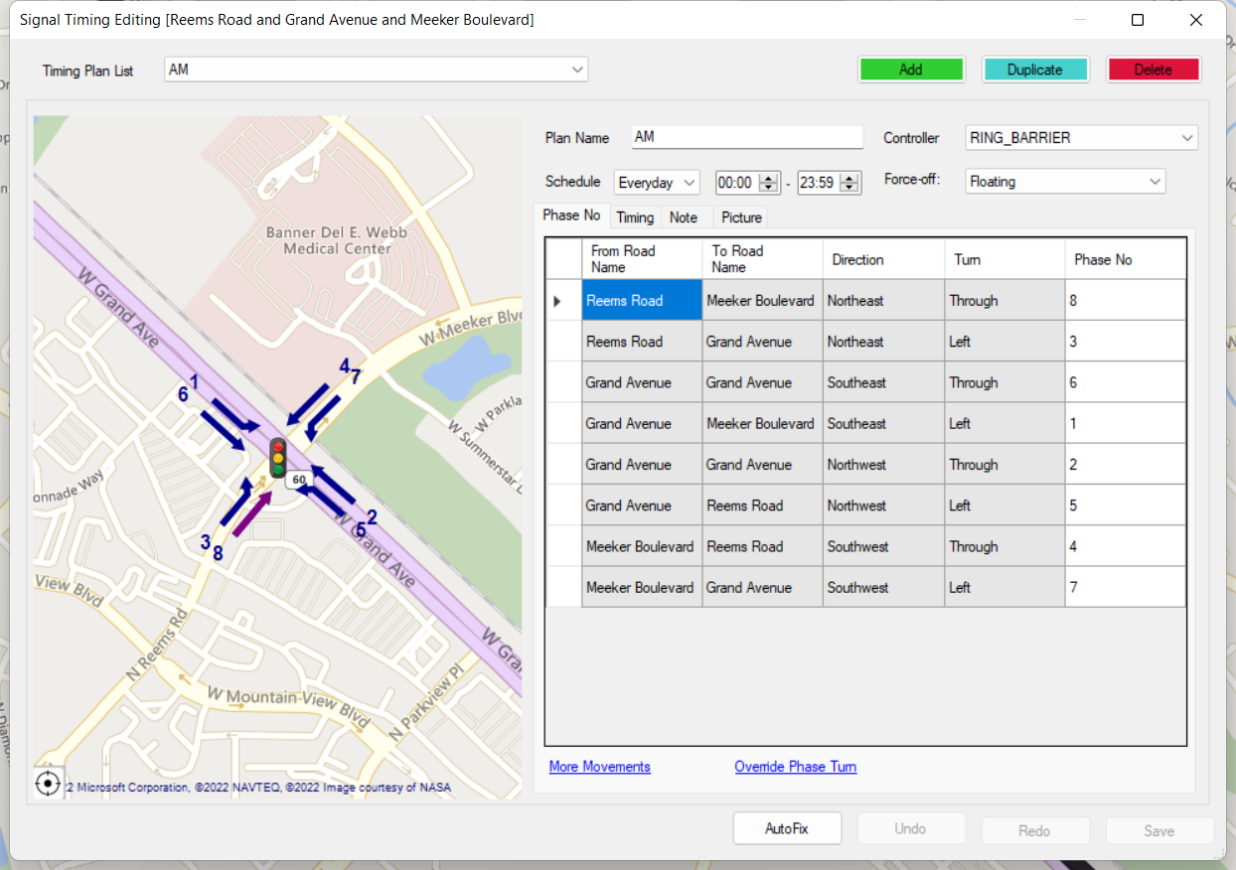
16

Slide 31
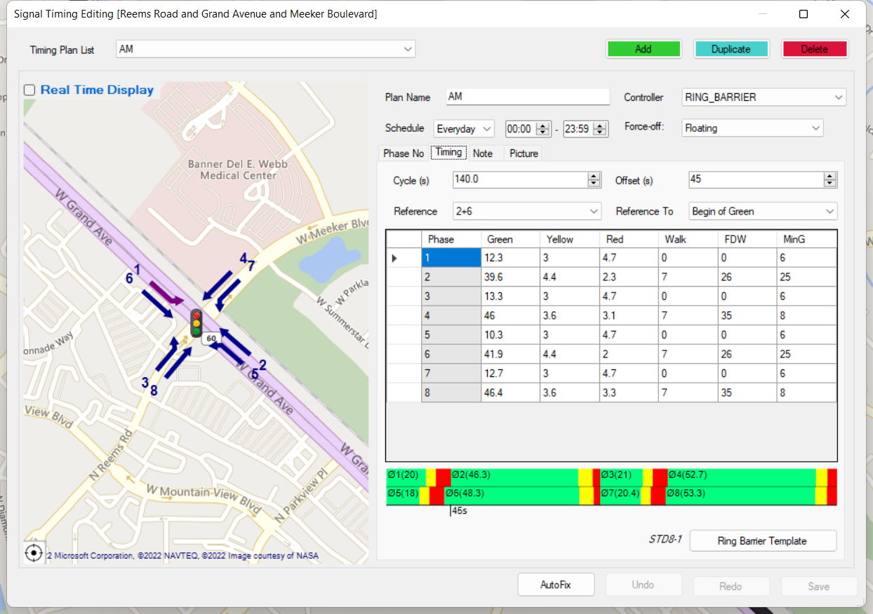
16

Slide 32
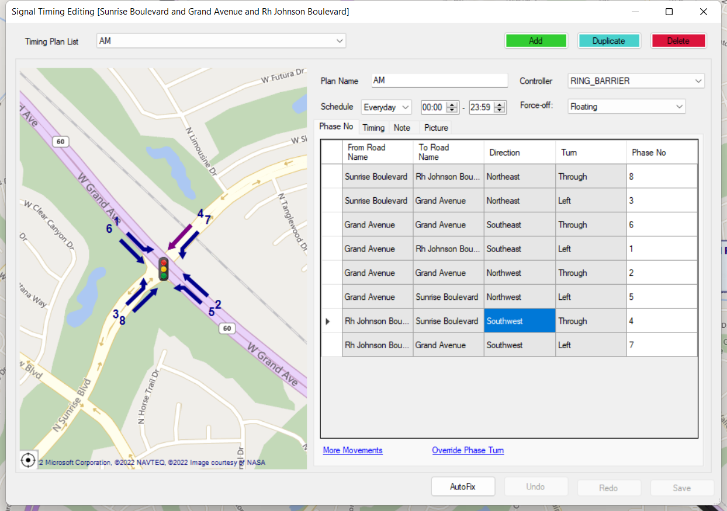
17

Slide 33
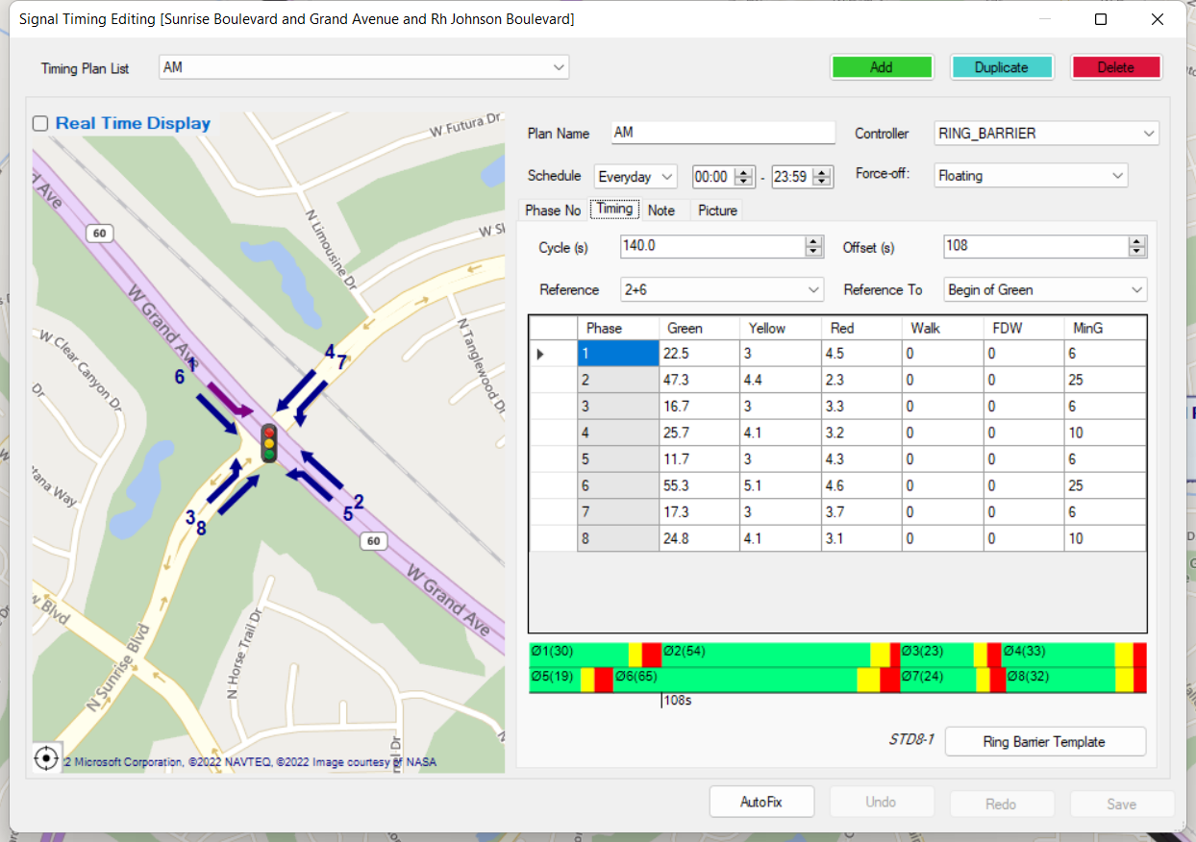
17

Slide 34
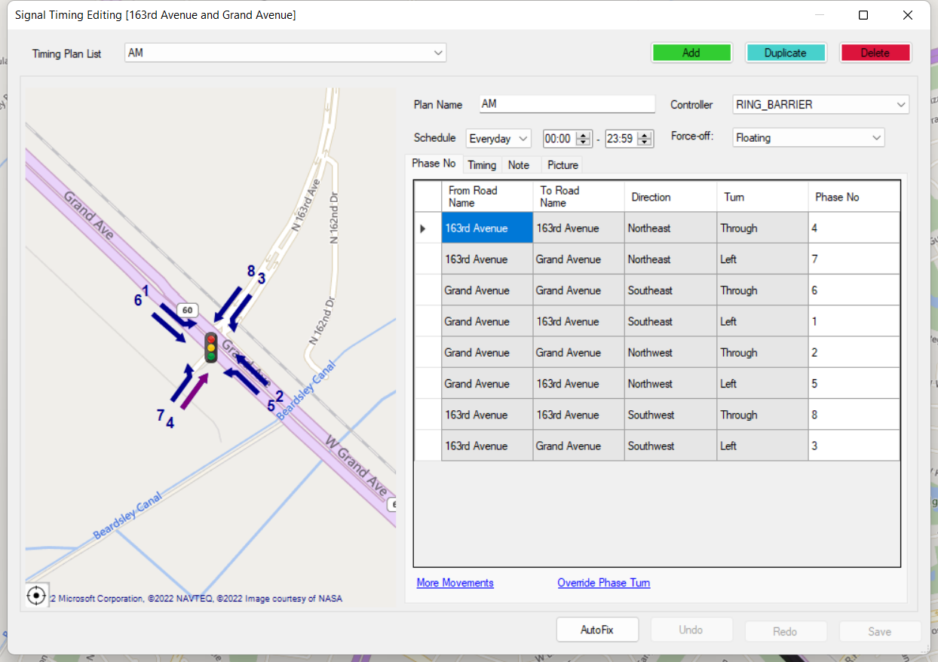
18

Slide 35
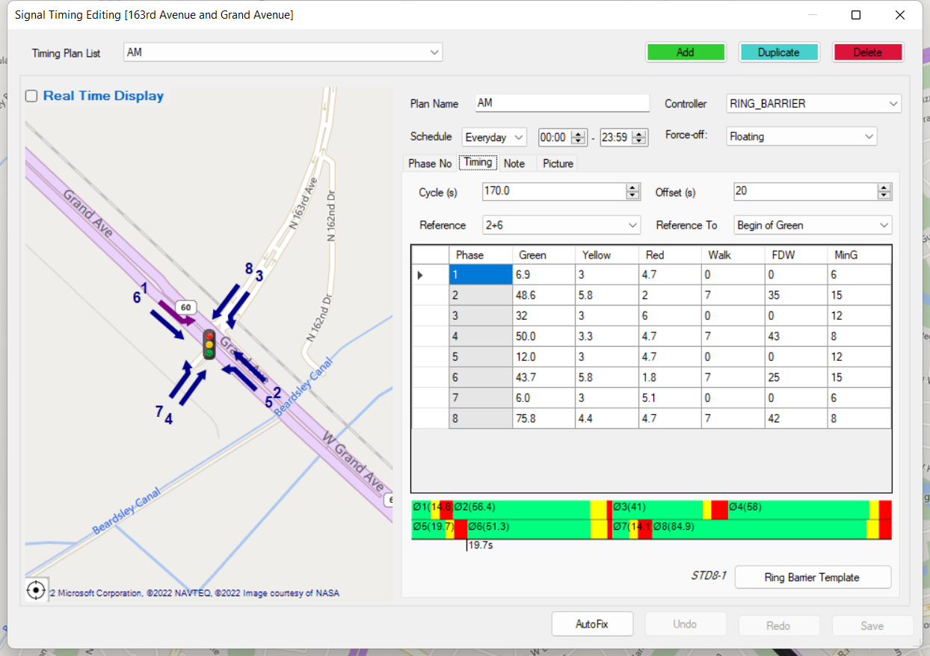
18

Slide 36
